Slide 1

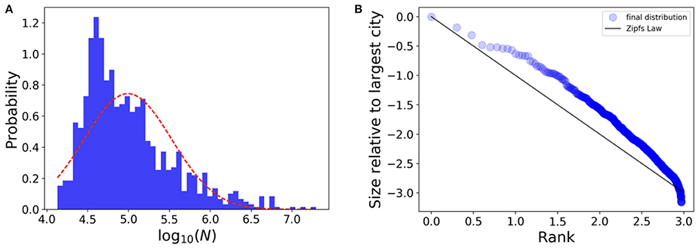
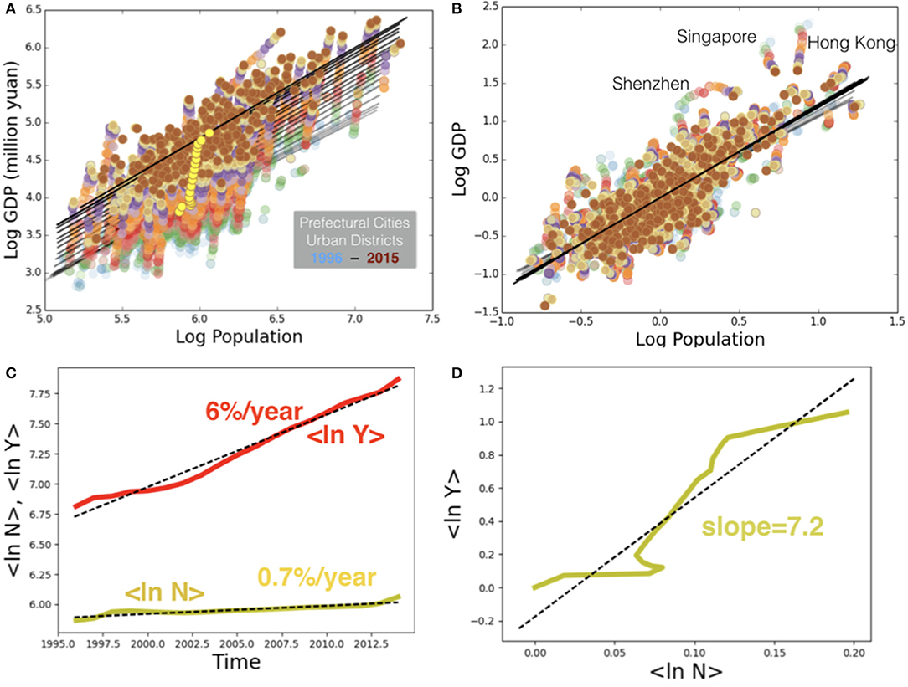
Case Study Three: Comparative Analysis of Cities in History
Bettencourt LMA and Lobo J (2019) Quantitative Methods for the Comparative Analysis of Cities in History. Front. Digit. Humanit. 6:17. doi: 10.3389/fdigh.2019.00017
Objectives: This paper presents several quantitative methodologies that allows us to analyze characteristics like population or GDP of different societies and cities.
Data Sources
China Data Online
United States Census Bureau
Data
U.S. Metropolitan Statistical Area Datasets (United States Census Bureau)
GDP and Population Data of Chinese Cities (1998-2015) (China Data Online)

Slide 2
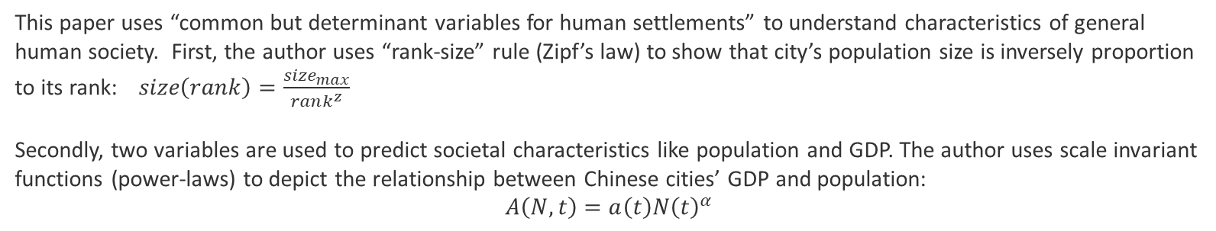
Case Study Three: Comparative Analysis of Cities in History
Methodology
This paper uses “common but determinant variables for human settlements” to understand characteristics of general human society. First, the author uses “rank-size” rule (Zipf’s law) to show that city’s population size is inversely proportion to its rank:$size\left(rank\right)=\frac{size_{max}}{rank^{z}}$
Secondly, two variables are used to predict societal characteristics like population and GDP. The author uses scale invariant functions (power-laws) to depict the relationship between Chinese cities’ GDP and population:
$$A\left(N,t\right)=a\left(t\right)N{\left(t\right)}^{α}$$
Flowchart
Data Inputs
Data Analysis
Outputs
US Census Data
Rank-Size Rule
(Zipf’s Law)
Histogram
Chinese City GDP and Population Data
Scatter Plot
Power Law
(Scale Invariant Functions)
Log Scale Plots

Slide 3
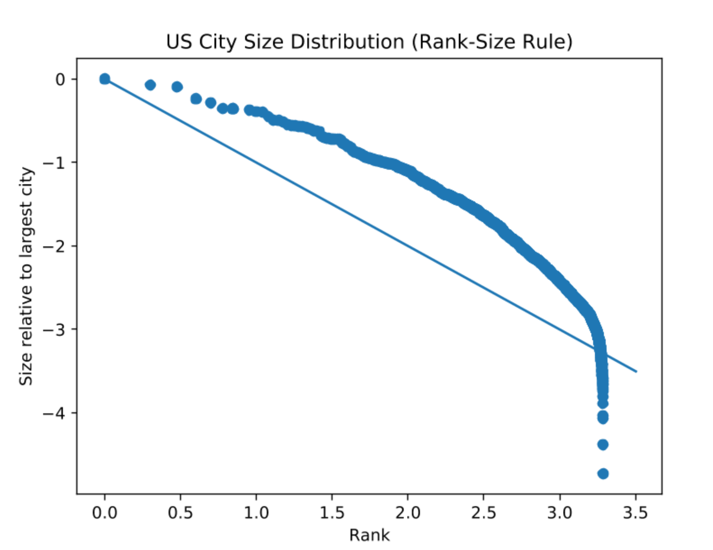
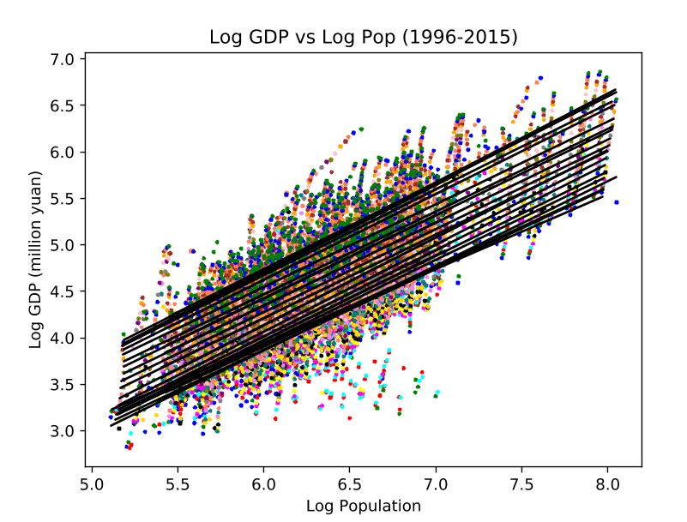
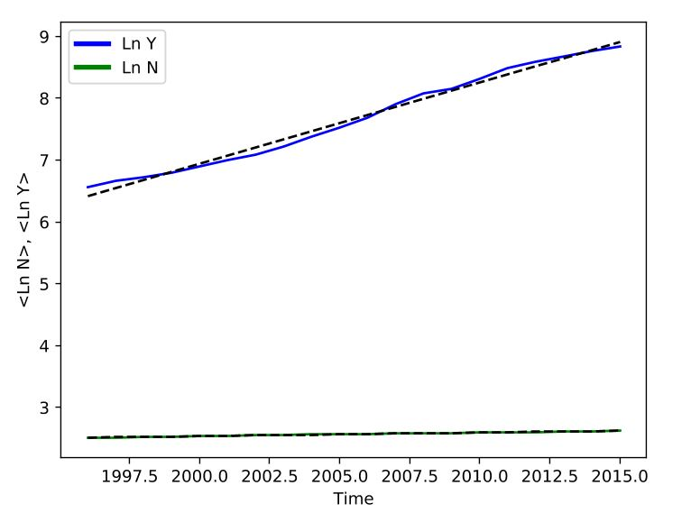
Case Study Three: Comparative Analysis of Cities in History
Outputs from the Workflow
Rank Size Rule
Growth of GDP (Y) and population (N) in log scale
Scaling of GDP and population size of Chinese Prefectural cities in last 20 years

Slide 4
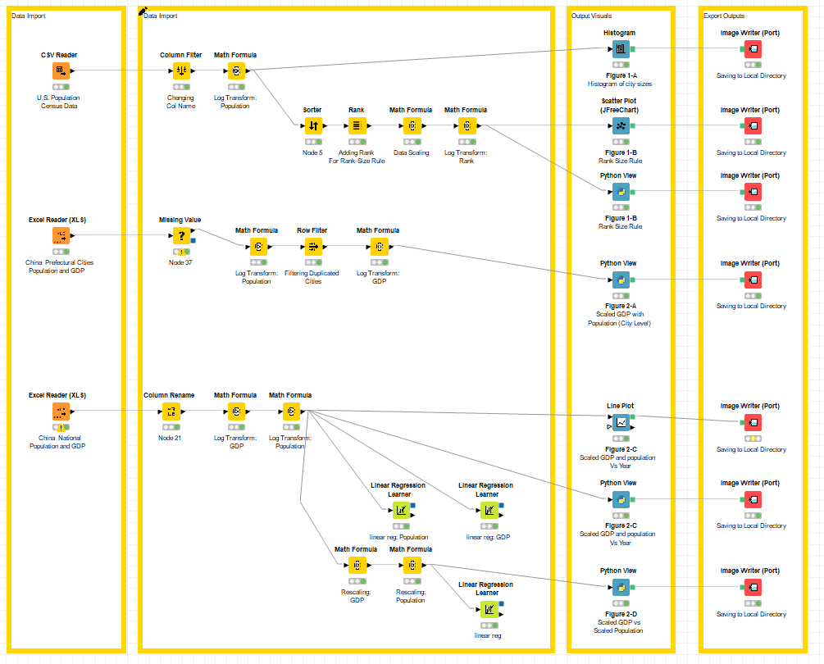
Case Study Three: Comparative Analysis of Cities in History
Rank-Size Rule
(US Cities)
Power-Laws
(Chinese Cities)

Slide 5
Case Study Three: Comparative Analysis of Cities in History
Steps for Running the Workflow
Step 1: Download data and unzip from https://drive.google.com/drive/u/0/folders/1Khx_VZTGGINsk5vZxhQppy5v_rxxPY93
Step 2: Download workflow from https://drive.google.com/drive/u/0/folders/17Udq9UJGBZowgQ-9okzLfL1OOTCt6_wX
Step 3: Open KNIME from local PC or China Data Lab Cloud Platform (in building)
Step 4: Import KNIME workflow file (Comparative Analysis of Cities in History.knwf)
Step 5: Configure all nodes in “data collection”
Step 6: Configure all nodes in “exporting output”
Step 6: Click Run function from the top menu
Step 7: Display the outputs:
Figure 1-A: Histogram of city sizes
Figure 1-B: Rank Size Rule
Figure 2-A: Scaled GDP with Population (City Level)
Figure 2-C: Scaled GDP and population vs. Year
Figure 2-D: Scaled GDP vs. Scaled Population

Slide 6
Case Study Three: Comparative Analysis of Cities in History
Summary
The workflow replicates the paper’s main parts and visualize the results in forms of tables, charts, and a map.
From the results, it is found that the U.S. cities’ size/population distribution follows a single (Rank-Size Rule) variable approach does explain societal characteristics
By analyzing Chinese prefectural cities population and GDP, it is found that two variable (Power-Laws) approaches could determine characteristics of different societies
Limitation
The data that this KNIME workflow uses for prefectural cities of China’s GDP and population differ slightly from the research paper. Research paper includes other major cities like Singapore, but the KNIME workflow does not include non-Chinese cities. Due to the differences of the data, the outputs of the workflow slightly differ from that of the paper.

Slide 7
References
Sara Hsu & Shelley Nauss (2009) Employment impacts of a ‘green’ energy transition in China, China Economic Journal, 2:2, 219-237, DOI: 10.1080/17538960903083533
China Data Online https://www.china-data-online.com/
United States Census Bureau https://www.census.gov/programs-surveys/metro-micro/data.html

